Slide 1
Lecture 3: CNN: Back-propagation
boris. ginzburg@intel.com

Slide 2
Agenda
Introduction to gradient-based learning for Convolutional NN
Backpropagation for basic layers
Softmax
Fully Connected layer
Pooling
ReLU
Convolutional layer
Implementation of back-propagation for Convolutional layer
CIFAR-10 training

Slide 3
Good Links
http://yann.lecun.com/exdb/publis/pdf/lecun-01a.pdf
http://www.iro.umontreal.ca/~pift6266/H10/notes/gradient.html#flowgraph

Slide 4
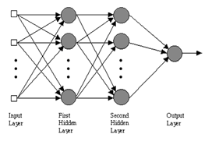
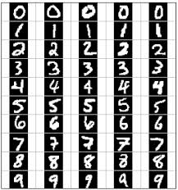
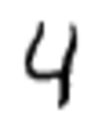
Gradient based training
Conv. NN is a just cascade of functions: f(x₀,w) → y, where
x₀ is image [28,28],
w – network parameters (weights, bias)
y – softmax output= probability that x belongs to one of 10 classes 0..9

Slide 5
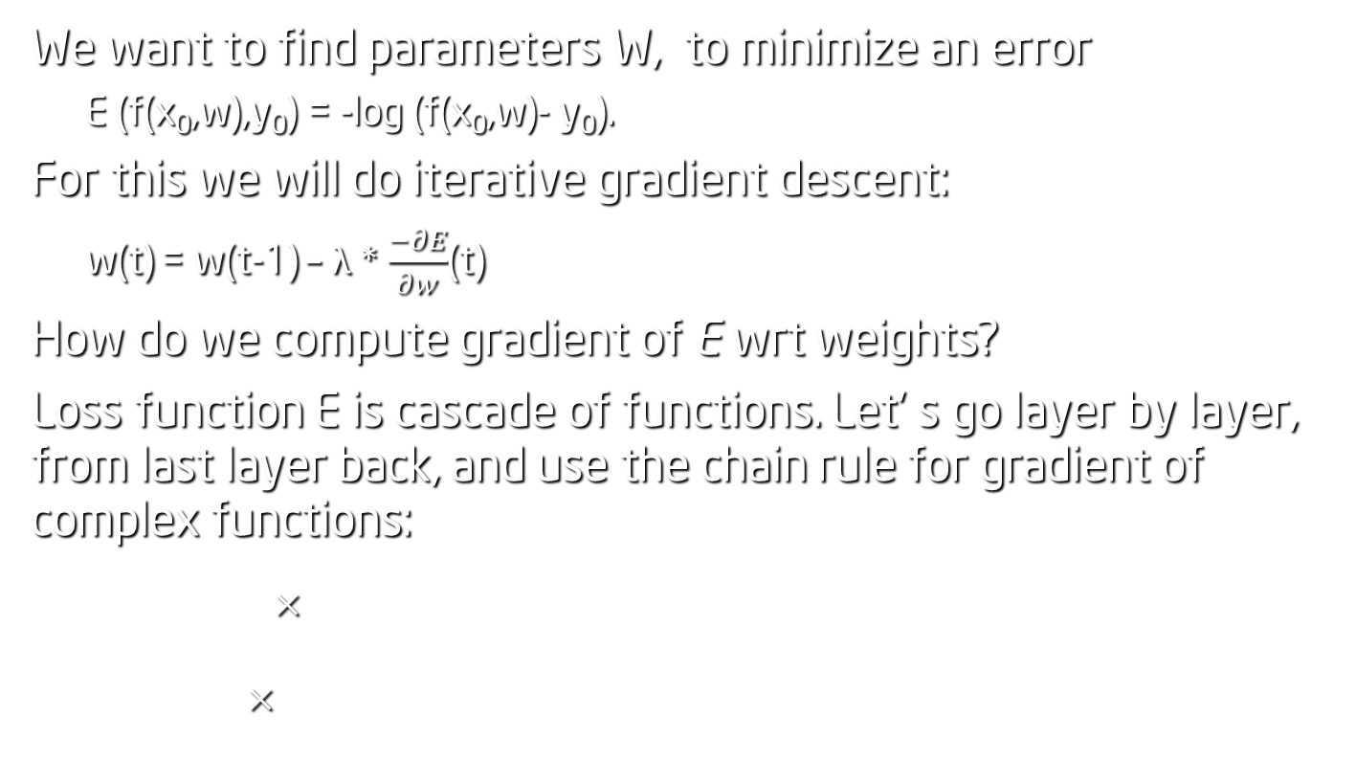
Gradient based training
We want to find parameters W, to minimize an error
E (f(x₀,w),y₀) = -log (f(x₀,w)- y₀).
For this we will do iterative gradient descent:
w(t) = w(t-1) – λ * $\frac{−∂E}{∂w}$(t)
How do we compute gradient of E wrt weights?
Loss function E is cascade of functions. Let’ s go layer by layer, from last layer back, and use the chain rule for gradient of complex functions:
$\frac{∂E}{∂y_{l−1}}=\frac{∂E}{∂y_{l}}×\frac{∂y_{l}(w,y_{l−1})}{∂y_{l−1}}$
$\frac{∂E}{∂w_{l}}=\frac{∂E}{∂y_{l}}×\frac{∂y_{l}(w,y_{l−1})}{∂w_{l}}$

Slide 6
LeNet topology
FORWARD
Soft Max + LogLoss
BACKWARD
Inner Product
ReLUP
Inner Product
Pooling [2x2, stride 2]
Convolutional layer [5x5]
Pooling [2x2, stride 2]
Convolutional layer [5x5]
Data Layer

Slide 7

Layer:: Backward( )
class Layer {
Setup (bottom, top); // initialize layer
Forward (bottom, top); //compute : $y_{l}=f\left(w_{l}, y_{l−1}\right)$
Backward( top, bottom); //compute gradient
}
Backward: We start from gradient $\frac{∂E}{∂y_{l}}$ from last layer and
1) propagate gradient back : $\frac{∂E}{∂y_{l}} →\frac{∂E}{∂y_{l−1}}$
2) compute the gradient of E wrt weights w_{l}: $\frac{∂E}{∂w_{l}}$

Slide 8
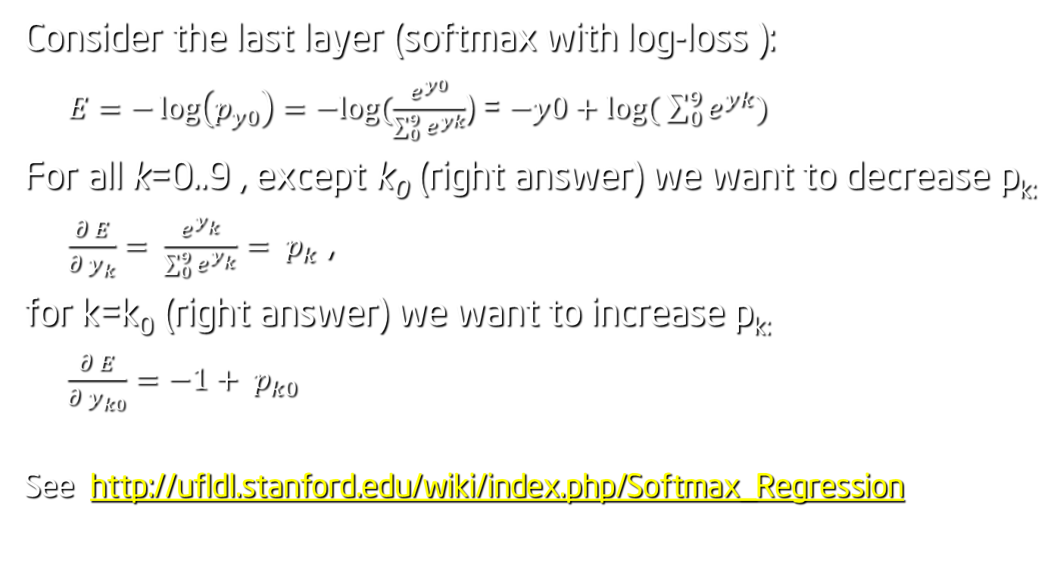
Softmax with LogLoss Layer
Consider the last layer (softmax with log-loss ):
$E=−\log\left(p_{y0}\right)=−log⁡(\frac{e^{y0}}{\sum_{0}^{9}{e^{yk}}}$) = $−y0+\log{( \sum_{0}^{9}{e^{yk}})}$
For all k=0..9 , except k₀ (right answer) we want to decrease p_{k:}
$\frac{∂ E}{∂ y_{k}}= \frac{e^{y_{k}}}{\sum_{0}^{9}{e^{y_{k}}}}= p_{k}$ ,
for k=k₀ (right answer) we want to increase p_{k:}
$\frac{∂ E}{∂ y_{k0}}=−1+ p_{k0}$
See http://ufldl.stanford.edu/wiki/index.php/Softmax_Regression

Slide 9

Inner product (Fully Connected) Layer
Fully connected layer is just Matrix – Vector multiplication:
$y_{l}=W_{l} ∗ y_{l−1}$
So $\frac{∂ E}{∂y_{l−1}}=\frac{∂ E}{∂y_{l}} ∗{W_{l}}_{}^{T}$
and $\frac{∂ E}{∂W_{l}}=\frac{∂ E}{∂y_{l}}∗y_{l−1}$
Notice that we need $y_{l−1}$, so we should keep these values on forward pass.

Slide 10

ReLU Layer
Rectified Linear Unit :
$y_{l}=\max{ (0,}y_{l−1})$
so $\frac{∂ L}{∂y_{l−1}}=\left\{\begin{aligned}=0, if (y_{l}<0) \\ = \frac{∂ L}{∂y_{l}}, otherwise\end{aligned}\right.$

Slide 11

Max-Pooling Layer
Forward :
for (p = 0; p< k; p++)
for (q = 0; q< k; q++)
y_{n} (x, y) = max( y_{n} (x, y), y_{n-1}(x + p, y + q));
Backward:
$\frac{∂ L}{∂y_{n−1}}(x+p,y+q)=\left\{\begin{aligned} =0, if ( y_{n }\left(x,y\right)!=y_{n−1 }\left(x+p,y+q\right)) \\ = \frac{∂ L}{∂ y_{n}}(x,y), otherwise\end{aligned}\right.$
Quiz:
What will be gradient for Sum-pooling?
What will be gradient if pooling areas overlap? (e.g. stride =1)?

Slide 12

Convolutional Layer :: Backward
Let’ s use the chain rule for convolutional layer
$\frac{∂E}{∂y_{l−1}}=\frac{∂E}{∂y_{l}}×\frac{∂y_{l}(w,y_{l−1})}{∂y_{l−1}}$ ;
$$\frac{∂E}{∂w_{l}}=\frac{∂E}{∂y_{l}}×\frac{∂y_{l}(w,y_{l−1})}{∂w_{l−1}}$$
3D - Convolution:
for (n = 0; n < N; n ++)
for (m = 0; m < M; m ++)
for(y = 0; y<Y; y++)
for(x = 0; x<X; x++)
for (p = 0; p< K; p++)
for (q = 0; q< K; q++)
y_{L} (n; x, y) += y_{L-1}(m, x+p, y+q) * w (n ,m; p, q);

Slide 13
Convolutional Layer :: Backward
Example: M=1, N=2, K=2.
Take one pixel in level (n-1). Which pixels in next level are influenced by it?
2x2
2x2

Slide 14
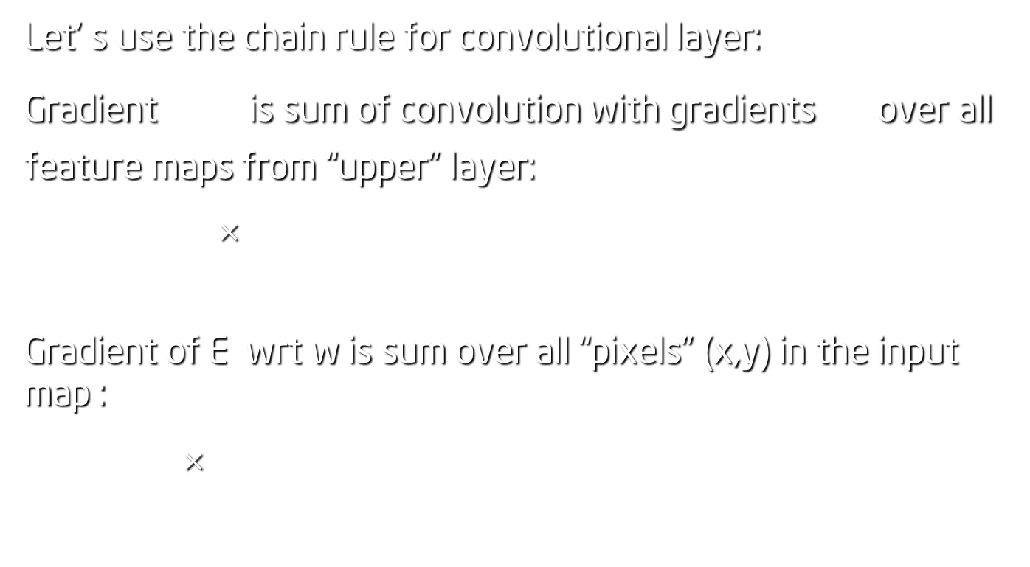
Convolutional Layer :: Backward
Let’ s use the chain rule for convolutional layer:
Gradient $\frac{∂E}{∂y_{l−1}}$ is sum of convolution with gradients $\frac{∂E}{∂y_{l}}$ over all feature maps from “upper” layer:
$\frac{∂E}{∂y_{l−1}}=\frac{∂E}{∂y_{l}}×\frac{∂y_{l}(w,y_{l−1})}{∂y_{l−1}}=\sum_{n=1}^{N}{back_corr(W,\frac{∂E}{∂y_{l}})}$
Gradient of E wrt w is sum over all “pixels” (x,y) in the input map :
$\frac{∂E}{∂w_{l}}=\frac{∂E}{∂l}×\frac{∂y_{l}(w,y_{l−1})}{∂w_{l}}= \sum_{\begin{aligned}0≤x≤X \\ 0<y<Y\end{aligned}}{\left(\frac{∂E}{∂y_{l}}\left(x,y\right)°y_{l−1}(x,y)\right)}$

Slide 15
Convolutional Layer :: Backward
How this is implemented:
// im2col data to col_data
im2col_cpu( bottom_data , CHANNELS_, HEIGHT_, WIDTH_, KSIZE_, PAD_, STRIDE_,
col_data);
// gradient w.r.t. weight.:
caffe_cpu_gemm (CblasNoTrans, CblasTrans, M_, K_, N_, 1., top_diff, col_data , 1.,
weight_diff );
// gradient w.r.t. bottom data:
caffe_cpu_gemm (CblasTrans, CblasNoTrans, K_, N_, M_, 1., weight , top_diff , 0.,
col_diff );
// col2im back to the data
col2im_cpu(col_diff, CHANNELS_, HEIGHT_, WIDTH_, KSIZE_, PAD_, STRIDE_,
bottom_diff );

Slide 16
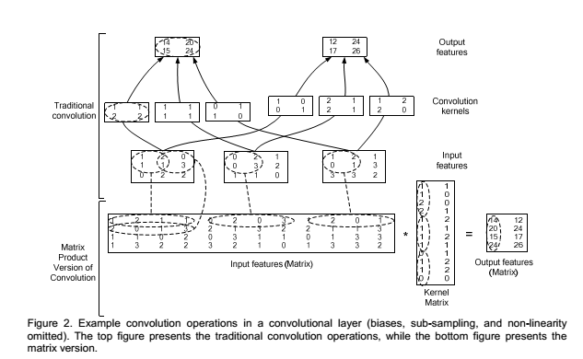
Convolutional Layer : im2col
Implementation is based on reduction of convolution layer to matrix – matrix multiply ( See Chellapilla et all , “High Performance Convolutional Neural Networks for Document Processing” )

Slide 17
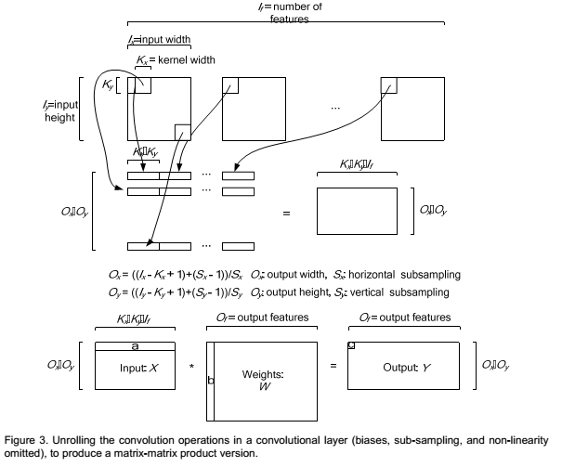
Convolutional Layer: im2col

Slide 18
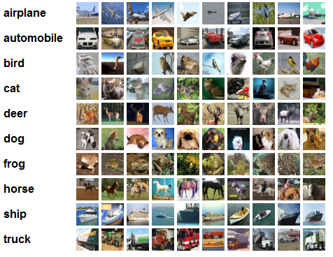
CIFAR-10 Training
http://www.cs.toronto.edu/~kriz/cifar.html
https://www.kaggle.com/c/cifar-10
60000 32x32 colour images in 10 classes, with 6000 images per class. There are:
50000 training images
10000 test images.

Slide 19
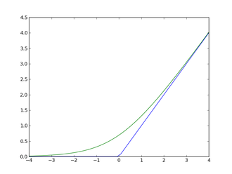
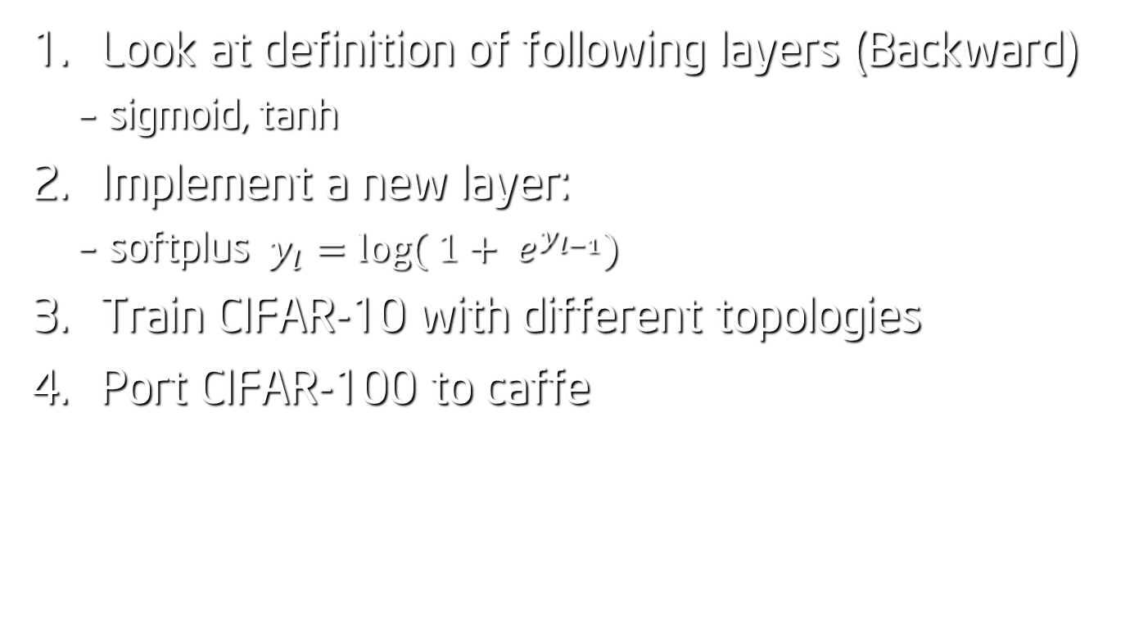
Exercises
Look at definition of following layers (Backward)
sigmoid, tanh
Implement a new layer:
softplus $y_{l}=\log{( 1+ e^{y_{l−1}})}$
Train CIFAR-10 with different topologies
Port CIFAR-100 to caffe

